Slide 1
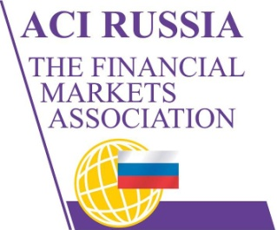
Update on Russian financial markets regulation: reflection of global changes in the local agenda and future proposals
Sergey Romanchuk,
Head Of FX&MM, Metallinvestbank,
President of ACI Russia, ACIFXC Member
NFEA Council Member
Exchange Council Member, Moscow Exchange
15th International Ruble Settlement Forum, London, 13.05.2014

Slide 2
ACI –The Financial Markets Association research
In response to the on-going regulatory reform within the Financial Markets, ACI – The Financial Markets Association, in collaboration with financial market consultants Adsatis Limited, has published a White Paper on ‘The Potential Impact of New Regulation on End Users in the FX Market’.
The purpose of this White Paper is to examine, through direct consultation with market users, the real impact of the new regulations on the FX market in Europe.
The White Paper highlights concerns around the imposition of:
▪ The trade level reporting,
▪ Transacting on approved electronic venues
▪ Central clearing
on a relatively transparent market with little obvious systemic risk.
The imminent implementation of trade level reporting attracted most feedback, with the majority of research participants expressing the opinion that the introduction of this regulatory requirement had been accompanied by great confusion and time pressure, caused by the lack of timely definitions. The (post implementation) request from ESMA to the European Commission to rule on these matters confirmed this impression.
The White Paper further discusses the potential impact these regulatory proposals, combined with the Basel3/CRD4 capital requirements might have on ‘Buy-side’ participants. While welcoming the overall objectives of prudent regulation, many research participants (corporates, pension funds and asset managers) expressed concerns. They fear that FX markets, in particular vanilla FX Forwards and Swaps, which are primarily used for hedging by these ‘End-users’, may be subjected to requirements originally devised to regulate the interest rate and credit derivatives markets post the financial markets crisis of 2007-2008.
15th International Ruble Settlement Forum, London, 13.05.2014

Slide 3
Dodd-Frank, EMIR – gives new standards to execution, clearing and reporting
Reporting: Mandatory for derivatives
Clearing: OTC Central Clearing and Exemptions for FX SWAPS
Execution: SEF, Algo /HFT regulation, Best Execution
Taxes: FTT
15th International Ruble Settlement Forum, London, 13.05.2014

Slide 4
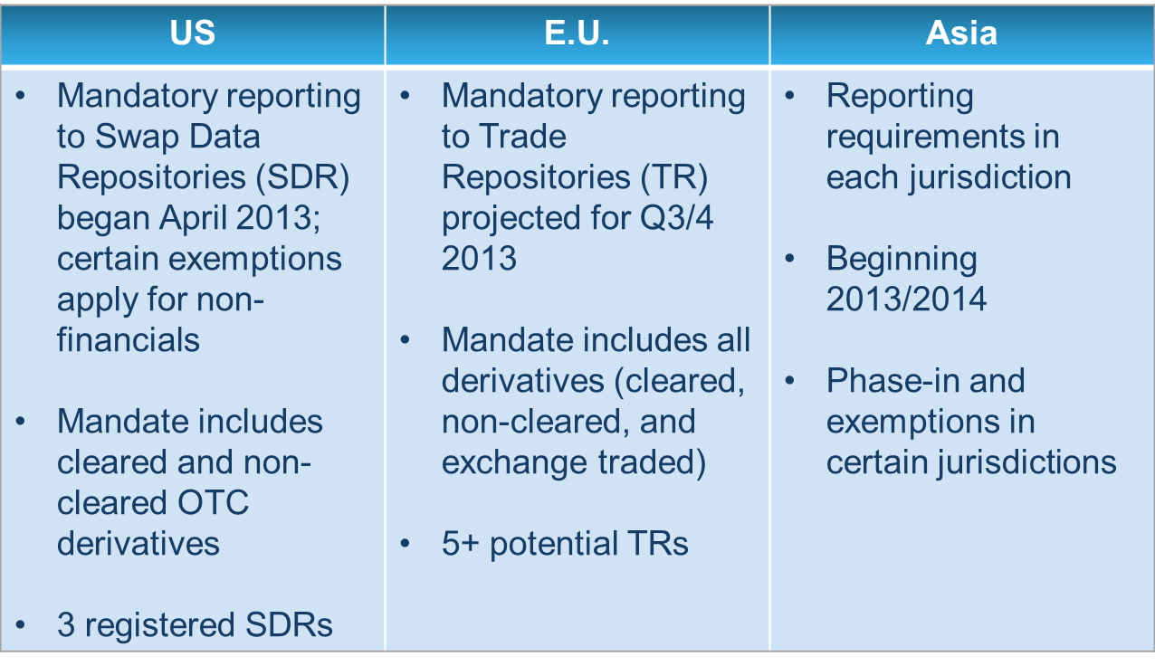
Reporting: Mandatory for derivatives
Russia
Reporting mandatory from 5NOV2013 for FX SWAPS and REPO
Reporting mandatory for all FX and OTC Products in 2014 (2015?). Some Internationals stop operations
NSD: 899 clients (companies and individuals) reported
15th International Ruble Settlement Forum, London, 13.05.2014

Slide 5
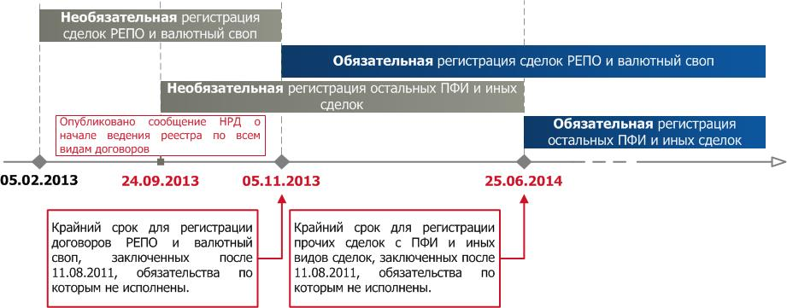
Reporting in Russia: initially mandatory for all derivatives, fx and repo deals from 25.06.2014
15th International Ruble Settlement Forum, London, 13.05.2014

Slide 6
Reporting in Russia: CBR proposal to have it mandatory for all derivatives, fx and repo deals from 01.01.2015
15th International Ruble Settlement Forum, London, 13.05.2014

Slide 7
Reporting in Russia: non residents
The CBR proposal states that for foreign participants reporting to Russian repository is NOT mandatory: it is a right and not an obligation:
“If one side of master agreement is foreign legal entity then repository service for such an agreement could be provided to the second side of the agreement (Russian legal entity) regardless providing service to foreign side of agreement.”
15th International Ruble Settlement Forum, London, 13.05.2014

Slide 8
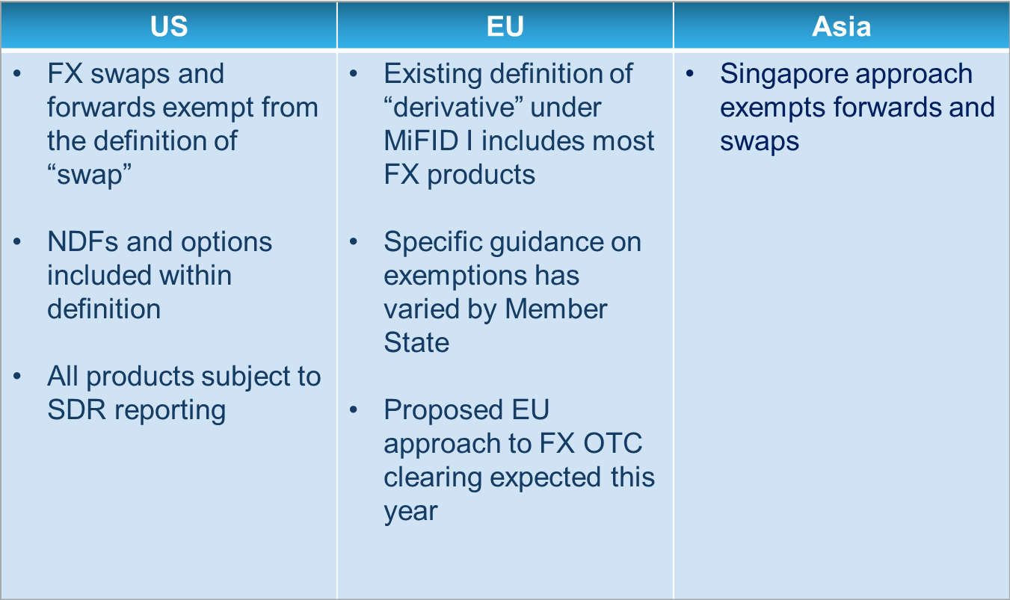
Clearing: OTC Central Clearing and Exemptions for FX SWAPS
Russia
OTC clearing by NCC started in 2013.
CBR have plans to make OTC clearing mandatory because of G20 (targeted as June 2015)
15th International Ruble Settlement Forum, London, 13.05.2014

Slide 9
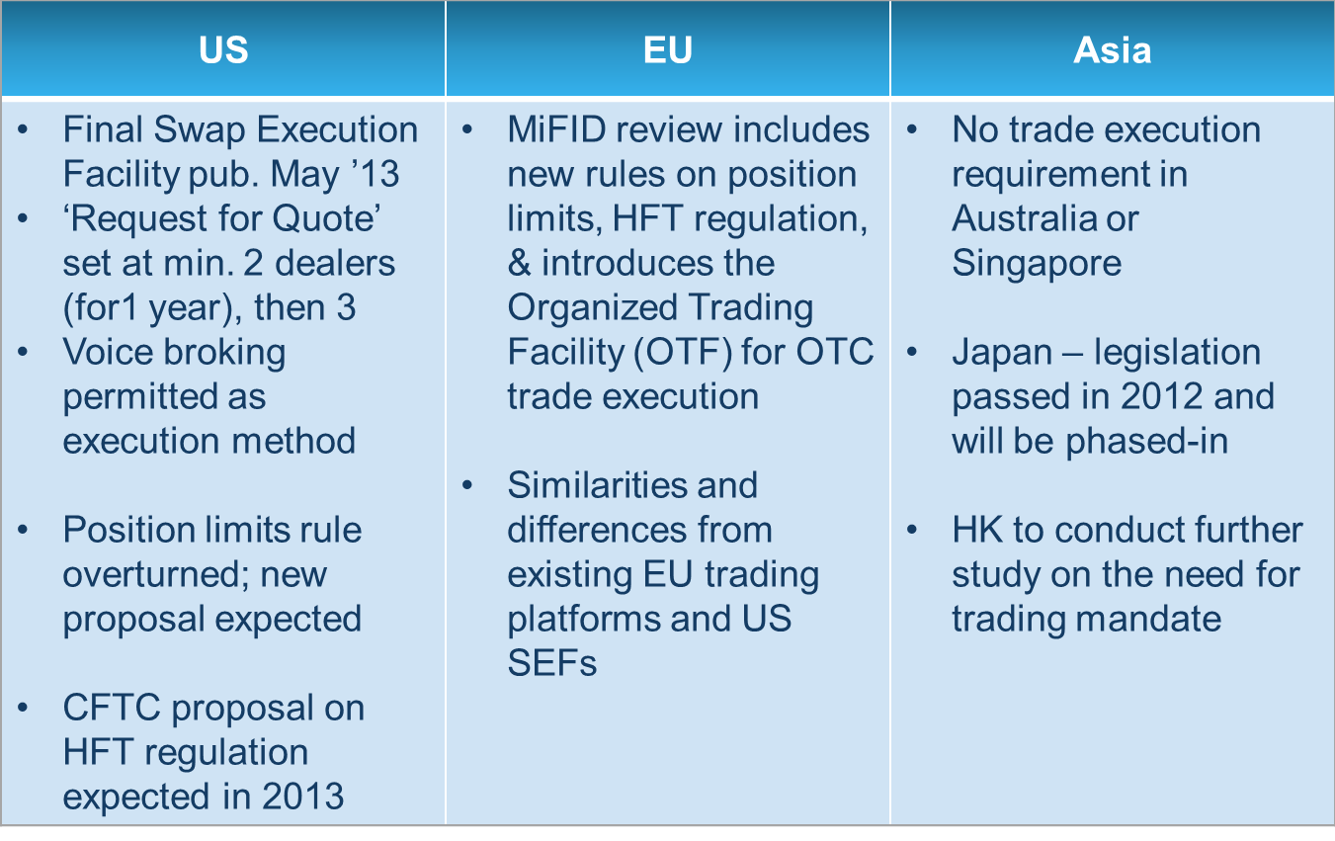
Execution: SEF, Algo /HFT regulation, Best Execution
Russia
HFT regulation managed by Moscow Exchange Tariffs Working group of Exchange Council was created
No sign of state regulation
15th International Ruble Settlement Forum, London, 13.05.2014

Slide 10
FX fixing scandals
ACIFXC: WM fixing scandal was actively discussed during meetings.
It was mentioned that uploading position from client fix order before fixing time is not always inside trading or manipulation: it is risk management.
Russia:
Moscow Exchange fixing was implemented for USDRUB based on local trading activity on spot fx. No regulation risk in Russia by definition. Will be addressed by “ALGO working group”.
Local EURRUB, EURUSD is under consideration (from triangular non arbitrage rule).
EMTA fixing is under regulation/legal risk due to not equal access to information which creates more opportunities for manipulation.
15th International Ruble Settlement Forum, London, 13.05.2014

Slide 11
Future proposals for Russia
NFEA and NFA merge (CBR and legislation regarding SRO).
Mandatory OTC Clearing in 2015 (CBR) and exempt FX delivery products in line with US and EU regulation (NFEA, NFA, ACI).
Make all markets of Moscow Exchange Group netted for margin requirements (futures/spot and forwards coming first in June 2014).
“Algo trading – trading rules” WG on Moscow Exchange: HFT, manipulation will be addressed.
More focus on alternatives (CNY, Gold, export contracts in RUB)
CBR keeps on track to facilitate international RUB usage and settlements, CLS is not under risk from Russia authorities.
15th International Ruble Settlement Forum, London, 13.05.2014

Slide 12
ACI Russia General Assembly 2014
Digital October Center 29th of May from 17-30 to 23-00.
About 250 participants from 80 institutions.
8 sponsoring companies: ICAP EBS, ME, CME, Thomson Reuters, Bloomberg, HotspotFX, FastMatch, SWIFT.
Free registration on web:
http://aci-russia.timepad.ru/event/121746/
15th International Ruble Settlement Forum, London, 13.05.2014

