Slide 1
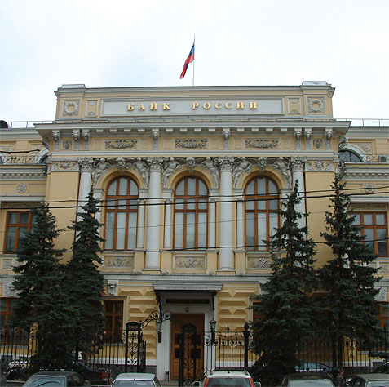
Anticipated changes in Russian National payment system 2014-2015
Vladimir Kulipanov, CBR
London, 15th IRSF
May 13, 2014

Slide 2
Changes to CBR PS
June 30, 2014
BESP will open 2 hours earlier in the morning

Slide 3
Anticipated extension of business day
Preliminary phase
Final phase
Regular phase
06-00
07-00
09-00
21-30
21-00
Moscow time (GMT+3)

Slide 4
Changes to CBR PS
June 30, 2014
BESP will open 2 hours earlier in the morning
During the interval from 09 a.m. till 5 p.m. msk Banks will be required to credit their clients in real time, if the money transfer is executed via BESP

Slide 5
Anticipated extension of business day
Preliminary phase
Final phase
Regular phase
Customer must be credited in real time
06-00
07-00
09-00
17-00
21-30
21-00
Moscow time (GMT+3)

Slide 6
Changes to CBR PS
June 30, 2014
BESP will open 2 hours earlier in the morning;
During the interval from 09 a.m. till 5 p.m. msk Banks will be required to credit their clients in real time, if the money transfer is executed via BESP;
New format of interbank transfer will be available for CLS Bank International, CLS settlement members, self-clearers and nostros. Proprietary format ED107 fully compatible with MT202, allowing STP.

Slide 7
Mapping ED 107 – MT 202
ED107
MT202
81 Информация о банке-плательщике
Sender
82 Информация о предыдущем инструктирующем банке
Receiver
52a:Ordering Institution
83 Информация о банке-отправителе
56a: Intermediary
84 Информация о банке-исполнителе
57a: Account with Institution
85 Информация об агенте банка-получателя
58a: Beneficiary Institution
72: Sender to Receiver Information
86 Информация о банке-получателе
74 Банковская информация

Slide 8
Changes to CBR PS
June 30, 2014
The CBR PS rules allow Central Bank to hire infrastructure service providers;
If contracted by CBR, SWIFT becomes part of CBR PS

Slide 9
CLS Project
The Bank of Russia interacts intensively with the CLS Bank International to on-board the Russian Rouble (RUB) to CLS.
Engagement ☑ 2012
Education ☑ 2012
Due diligence ☑ 2014
Implementation 2014
Nov 2014

Slide 10
CLS Project
To be accomplished by Nov 2014
Changes to the NPS Act (National Law)
Foreign banks and central payment clearing counterparties (CPCC) are allowed to participate in CBR PS;
Protection for the accounts of CPCCs against funds arrests, seizures, attachments, and against hold up of the operations
Open Correspondent Account to CLS Bank International
Implications of US HIRE FATCA Law

Slide 11
Thank you for attention!

